Slide 1

UNIT -5
Graph Theory

Slide 2
Birth of Graph Theory
The Konigsberg Bridge Problem
The city of Konigsberg was located on the Pregel river
in Prussia.
The city occupied 2 islands plus areas on both banks.
These regions were linked by 7 bridges.
The citizens wondered whether they could leave
home, cross every bridge exactly once, and return home.

Slide 3
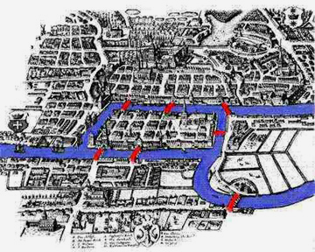
Konigsberg Bridge Problem

Slide 4
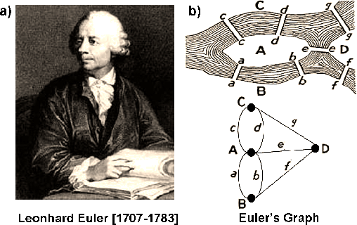

Slide 5
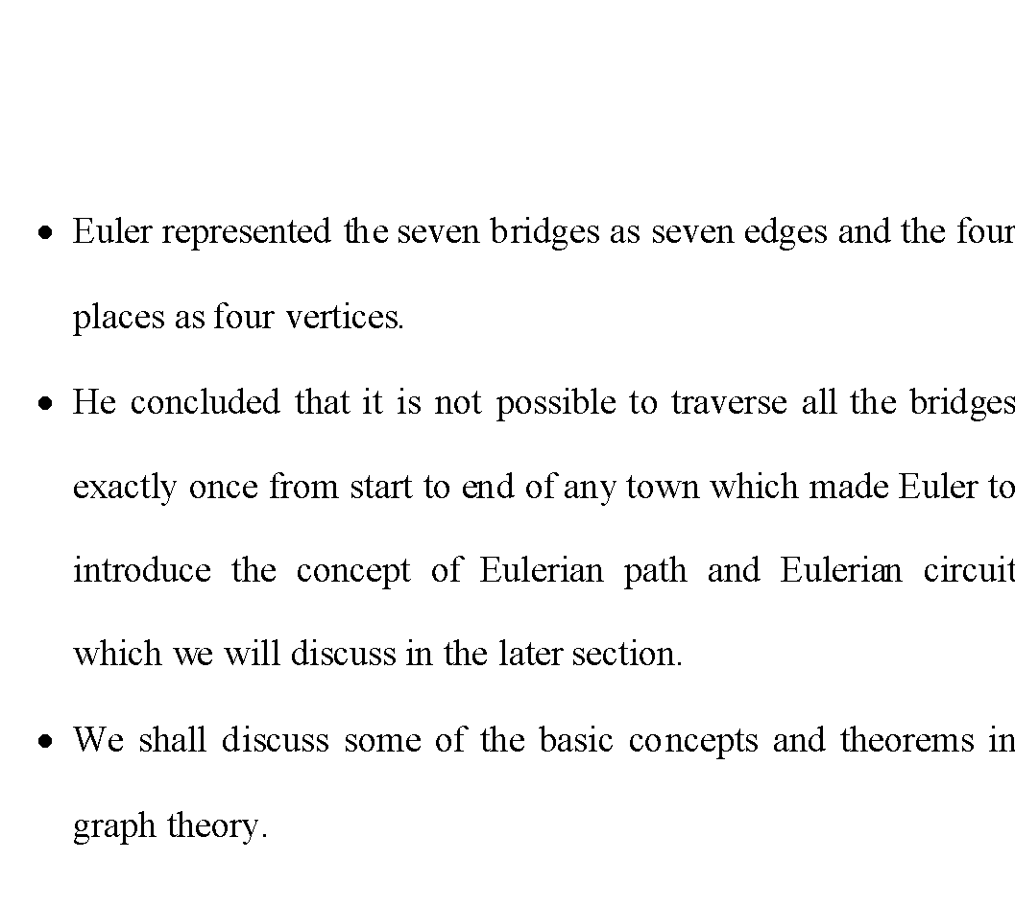

Slide 6
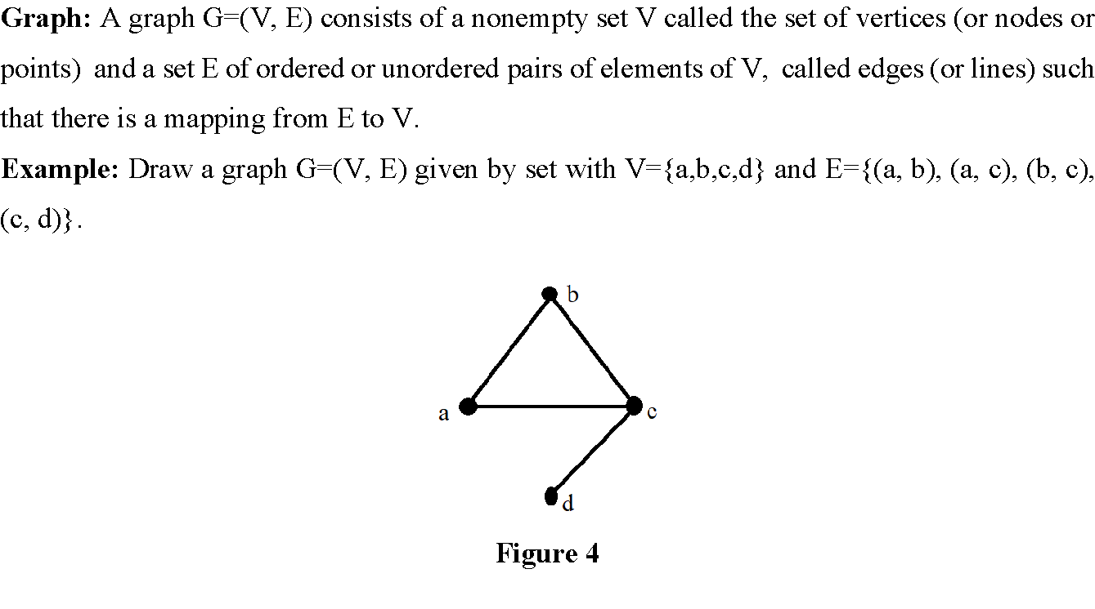

Slide 7
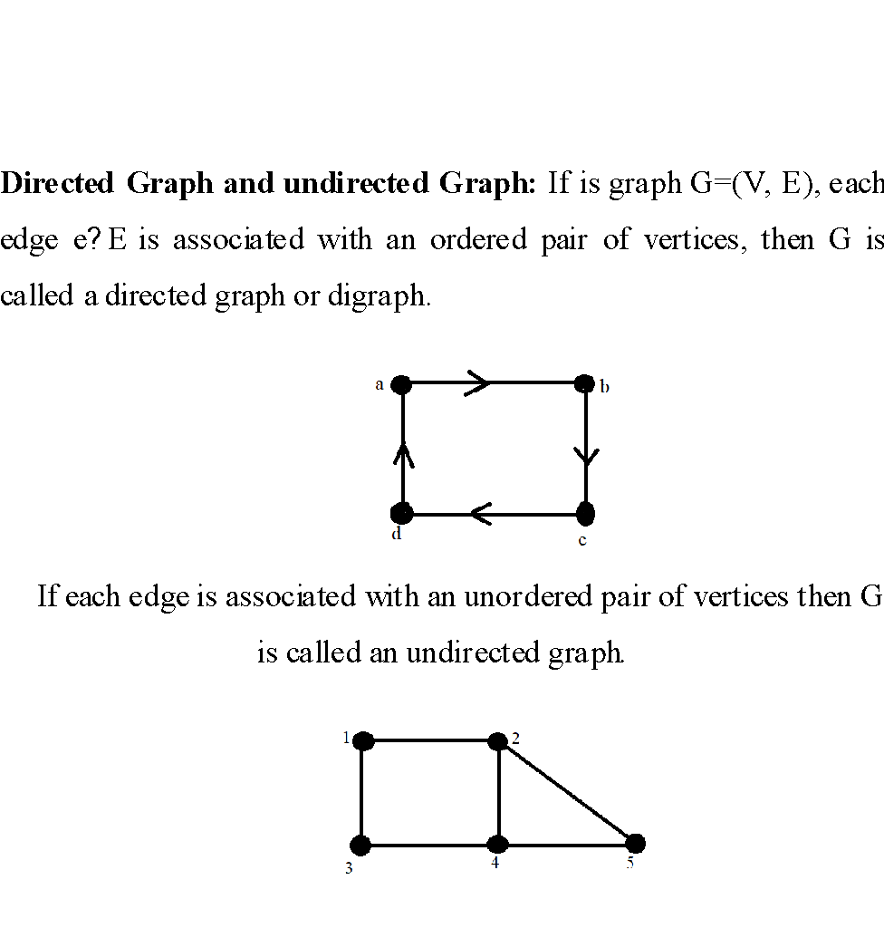

Slide 8
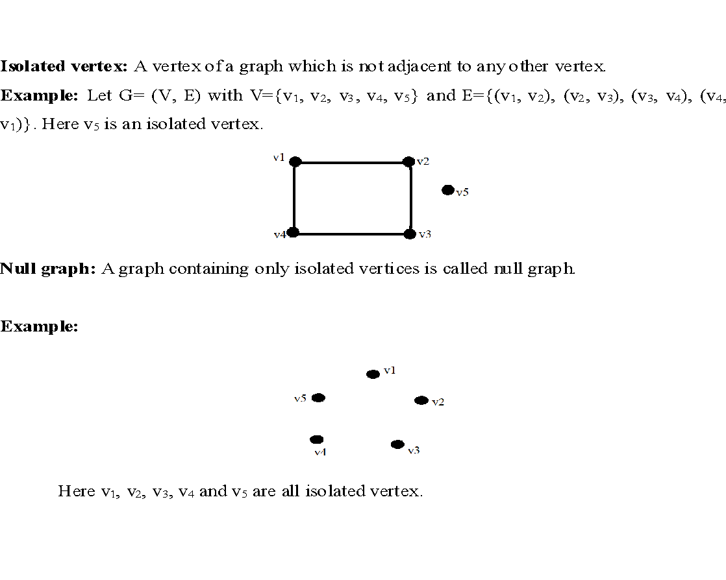

Slide 9
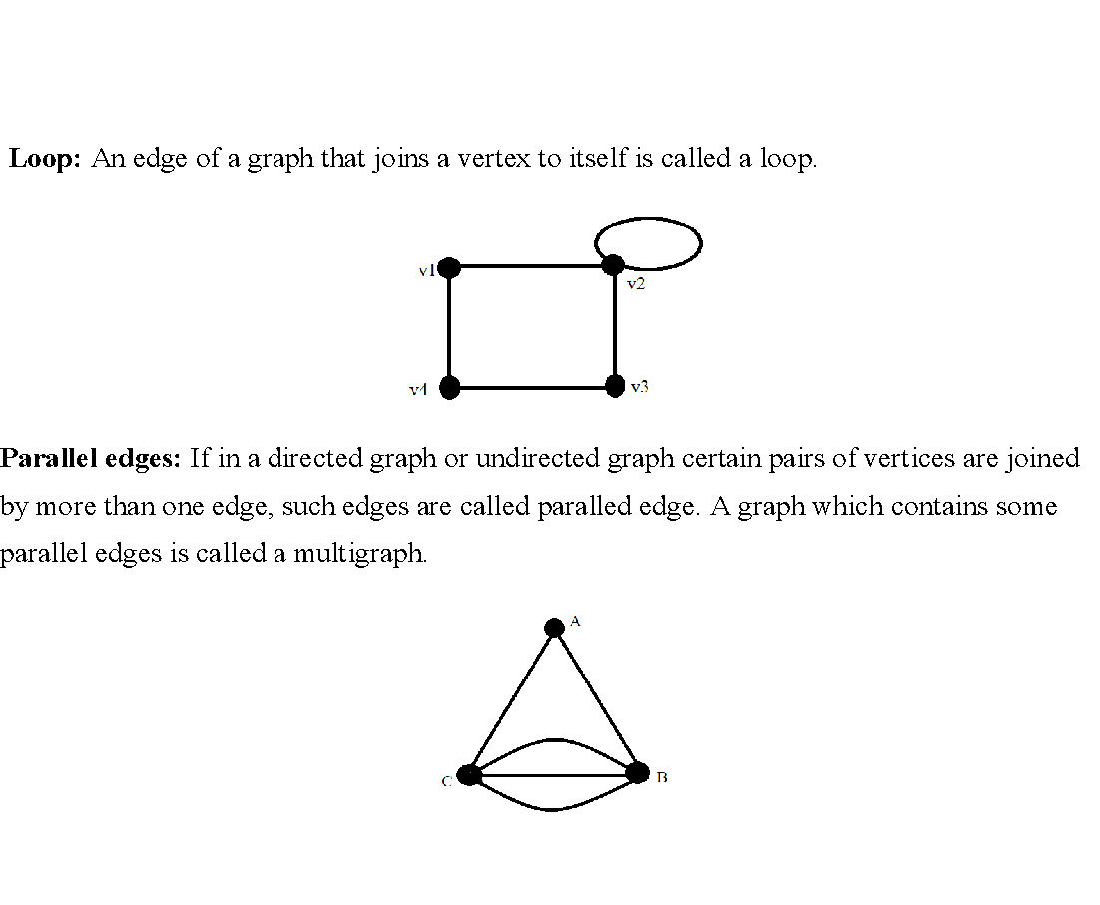

Slide 10
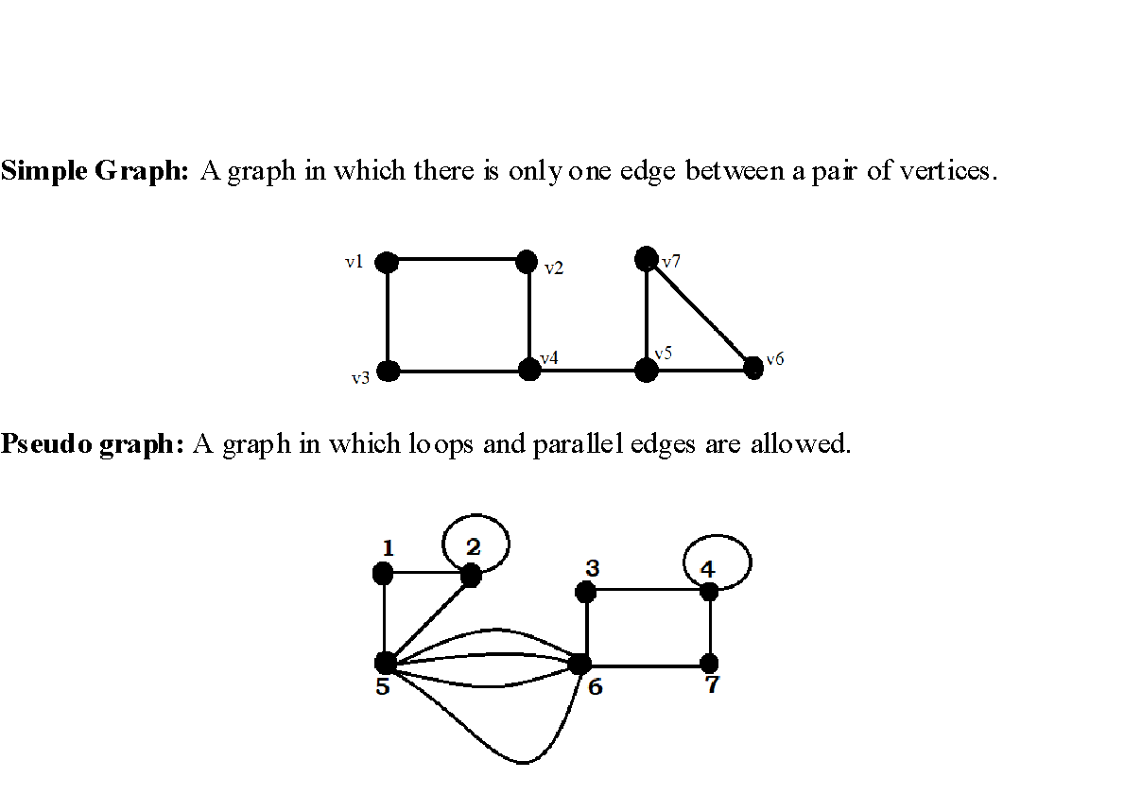

Slide 11
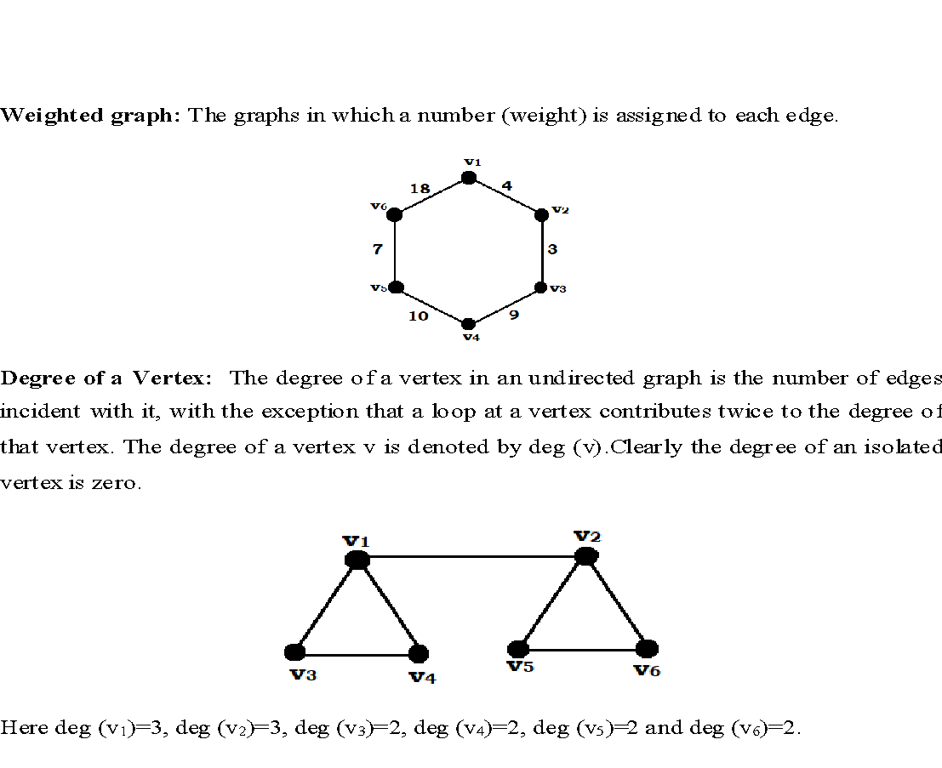

Slide 12
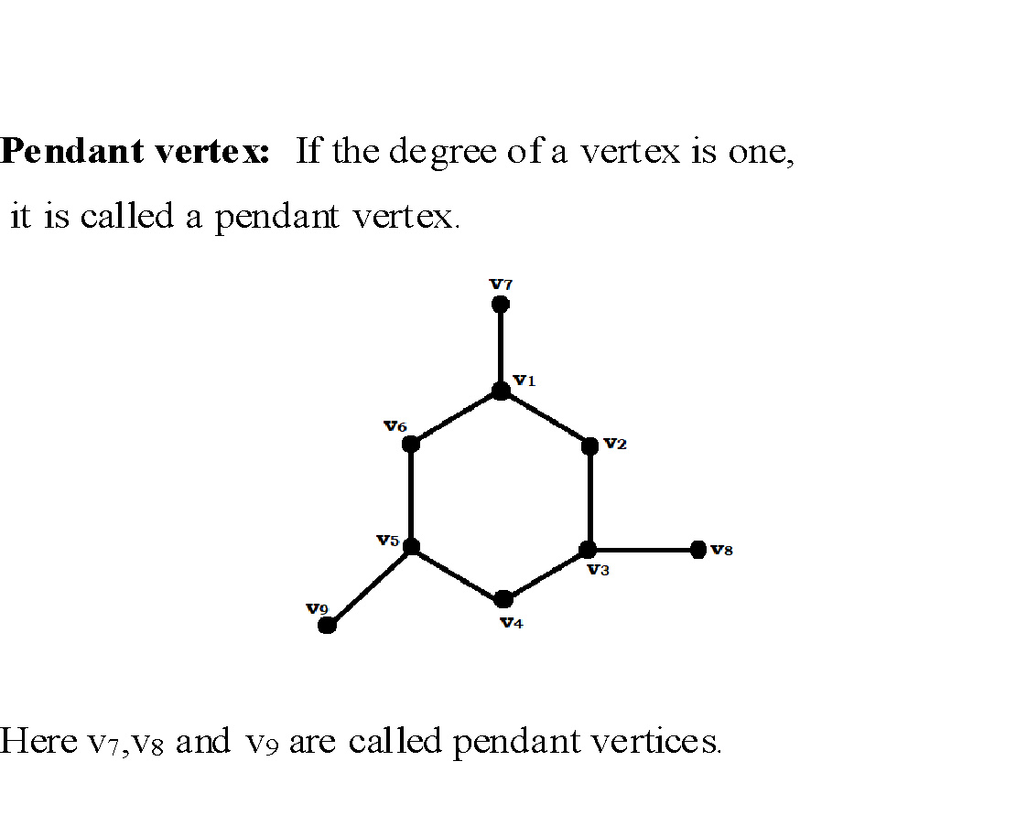

Slide 13
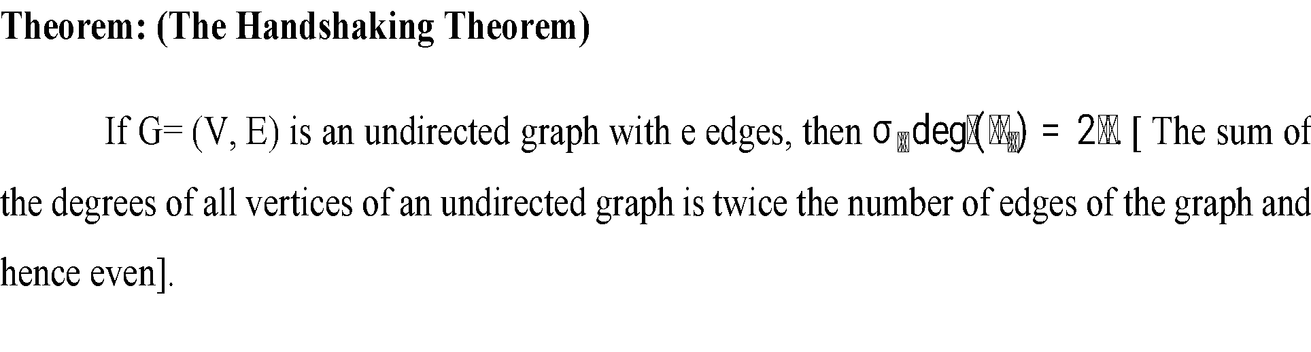
Proof: Since every edge is incident with exactly two vertices, every edge contributes 2 to the sum of the degree of the vertices.
Therefore all the e edges contribute (2e) to the sum of the degrees of the vertices.
Hence the proof.

Slide 14

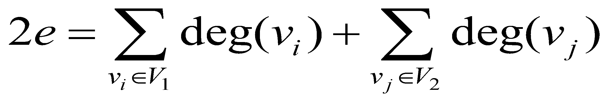
Theorem: The number of vertices of odd degree in an undirected graph is even.
Proof:
Let G=(V,E) be the undirected graph. Let V₁ and V₂ be the set of vertices of G of even and odd degrees respectively.
Then by handshaking theorem,
- (1)

Slide 15
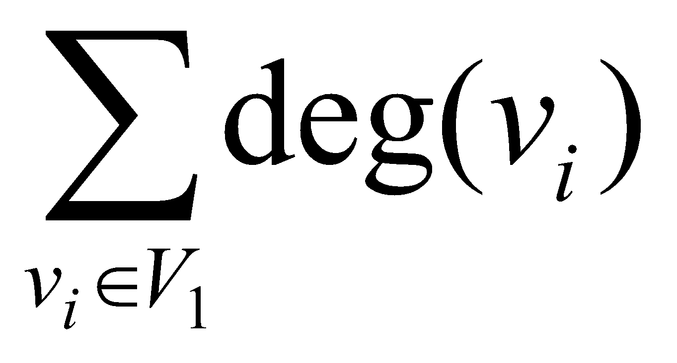
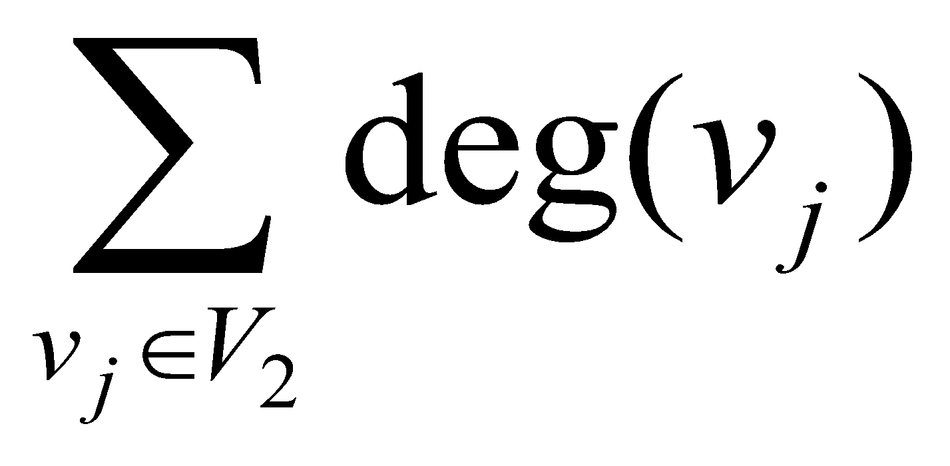
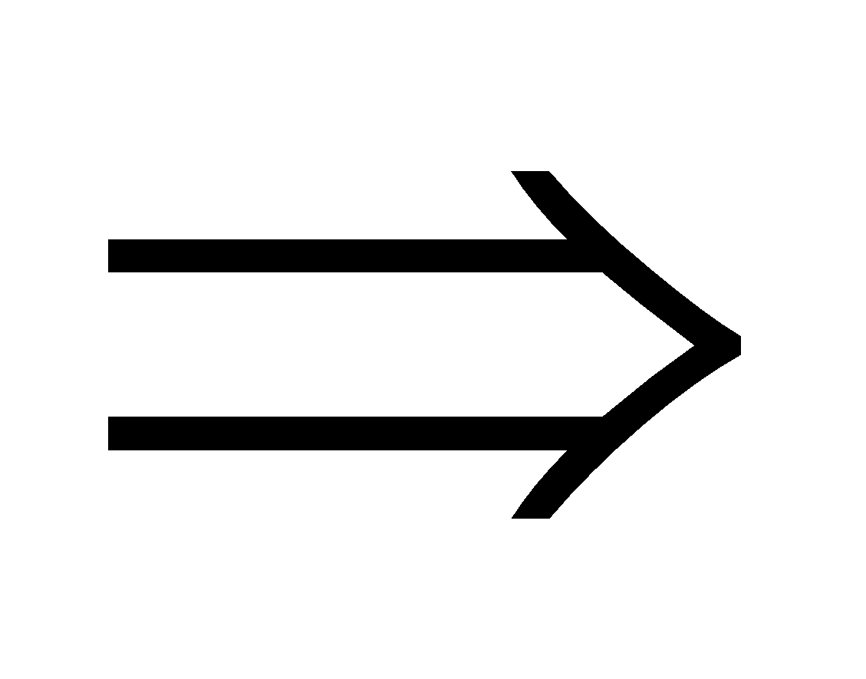
Since each deg(v_{i}) is even, is even
As left hand side of the equation – (1) is even,
we get is even.
the number of vertices of odd degree is even.

Slide 16
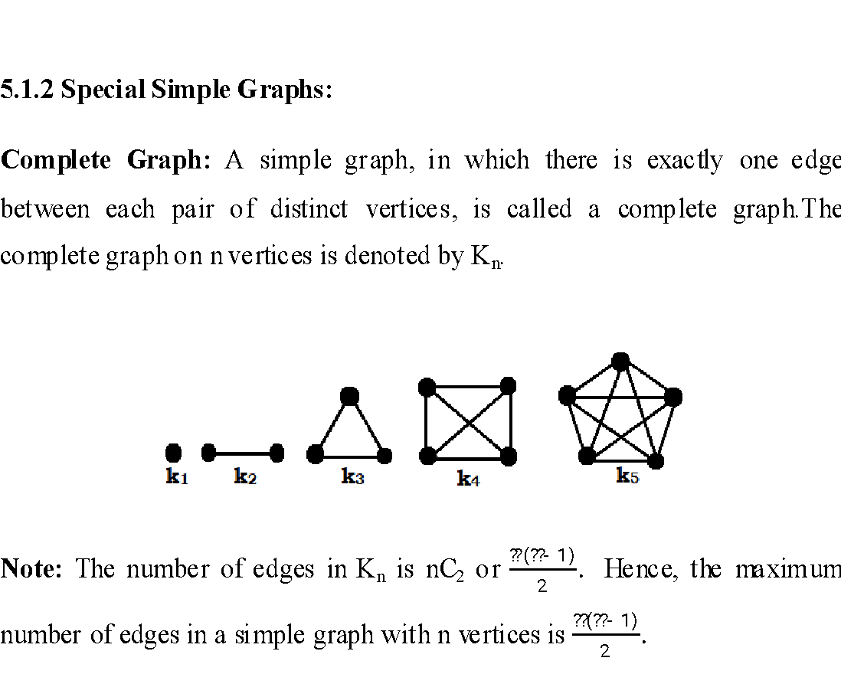

Slide 17
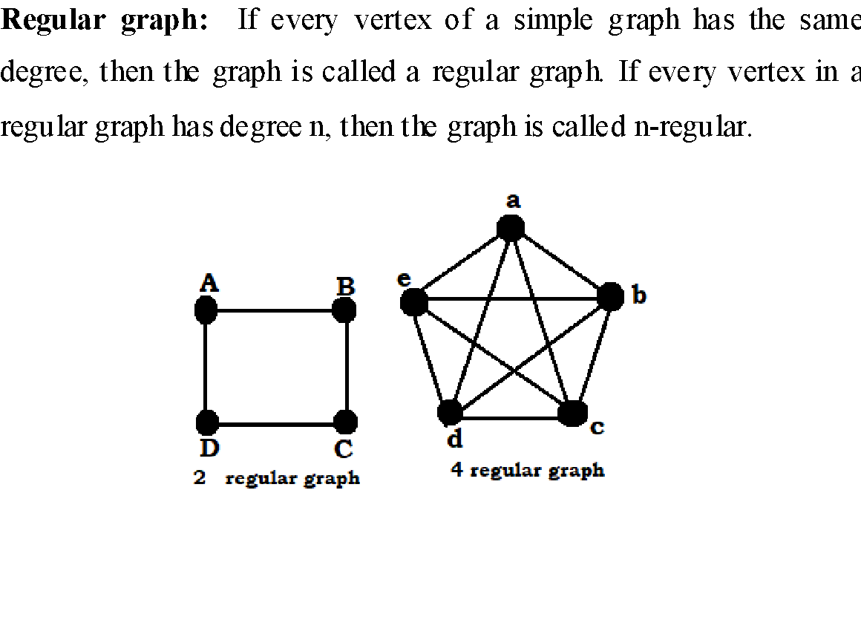

Slide 18
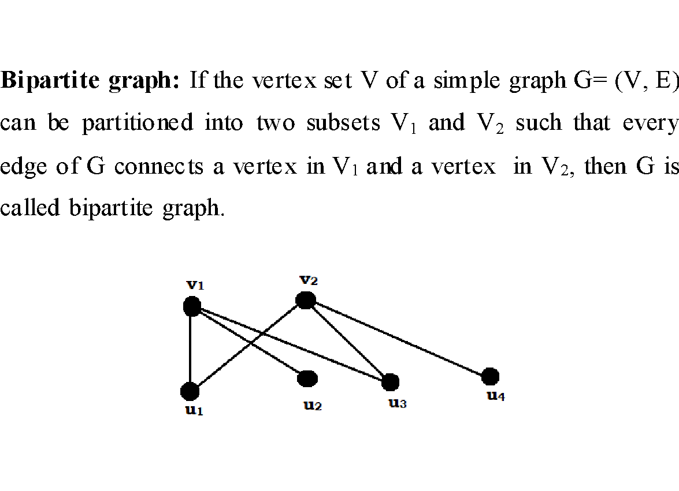

Slide 19
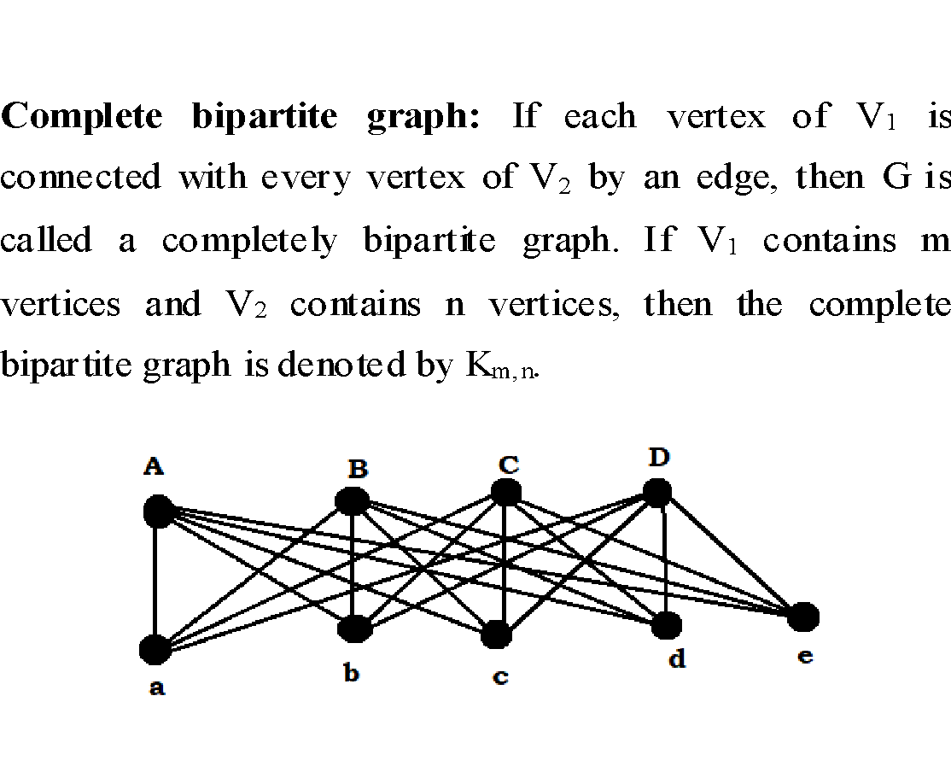

Slide 20
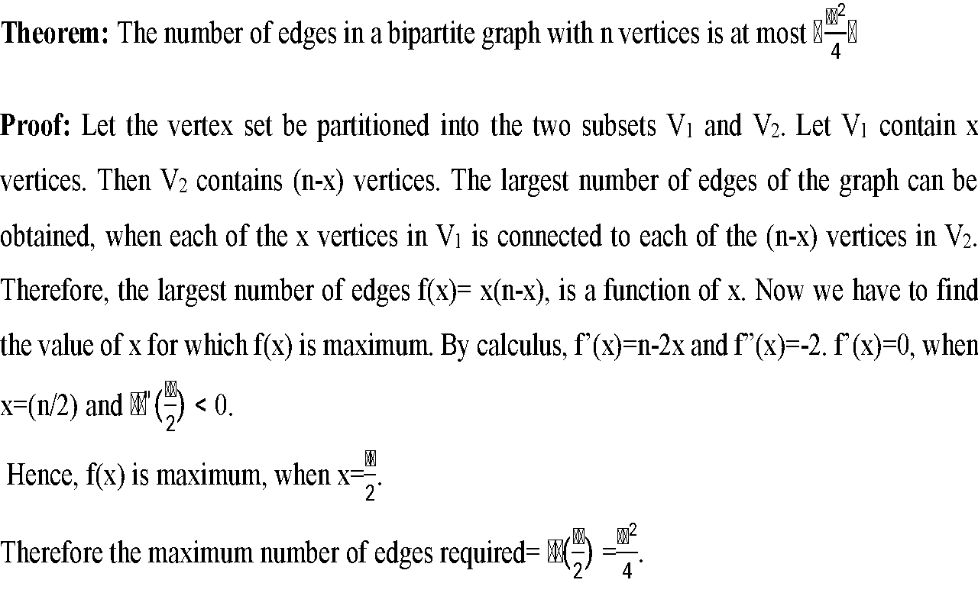

Slide 21

Isomorphism: The simple graphs G₁=(V₁,E₁) and G₂=(V₂,E₂) are isomorphic if there exists a one to one and onto function f from V₁ to V₂ with the property that a and b are adjacent in G₁, if and only if f(a) and f(b) are adjacent in G₂ for all a, b V₁. such a function f is called an isomorphism.
Two simple graphs that are not isomorphic are called nonisomorphic

Slide 22
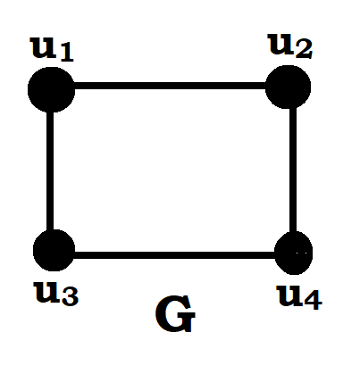
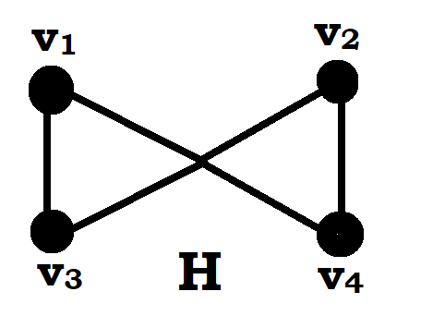
Show that the following graphs G and H are isomorphic.
1.
The graphs G and H are isomorphic

Slide 23
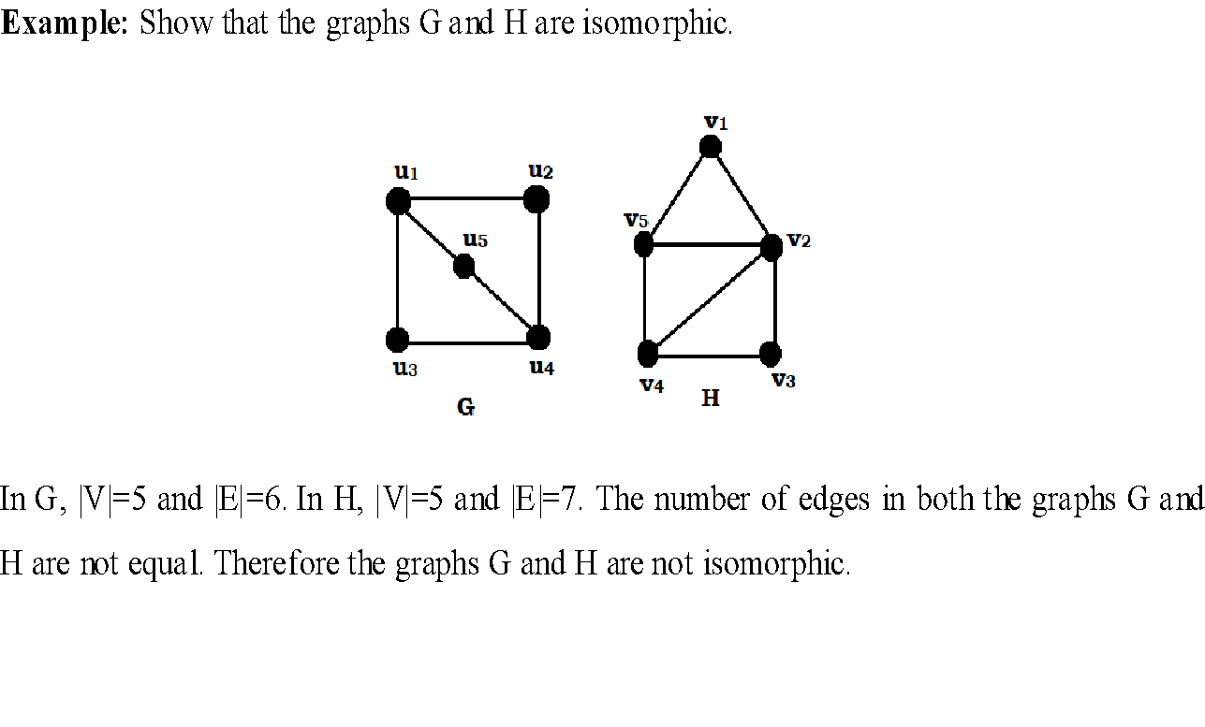

Slide 24
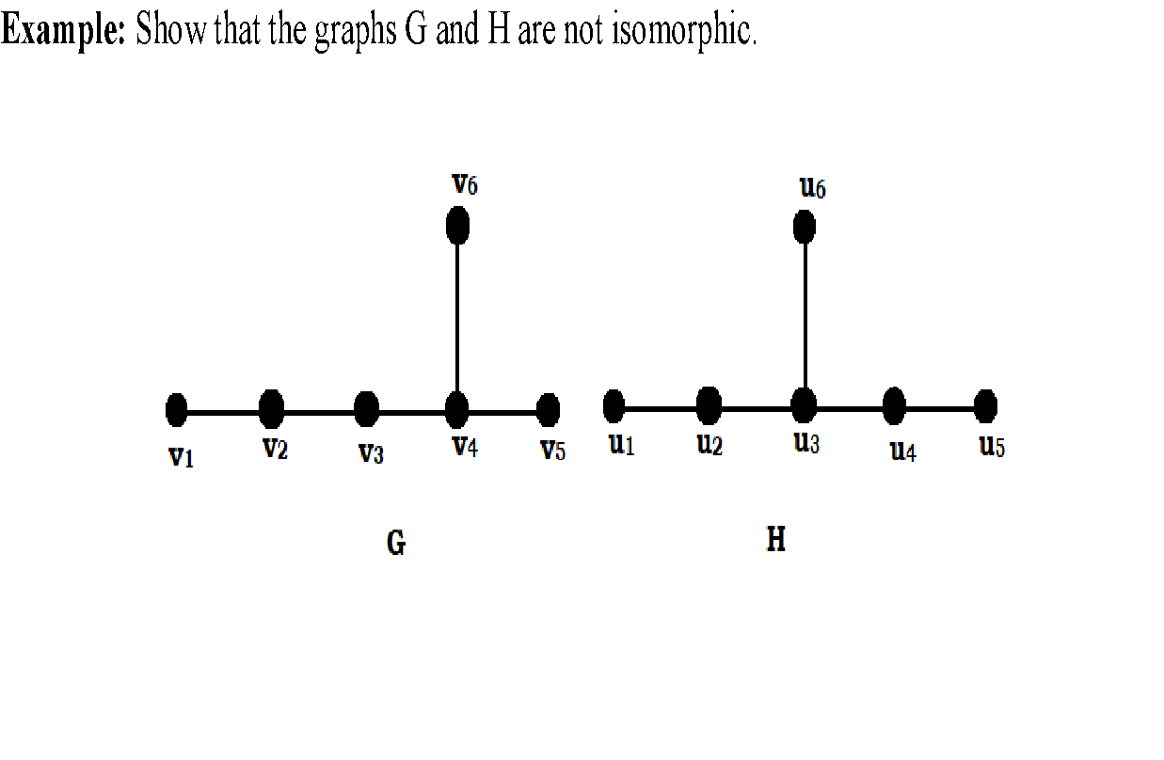

Slide 25
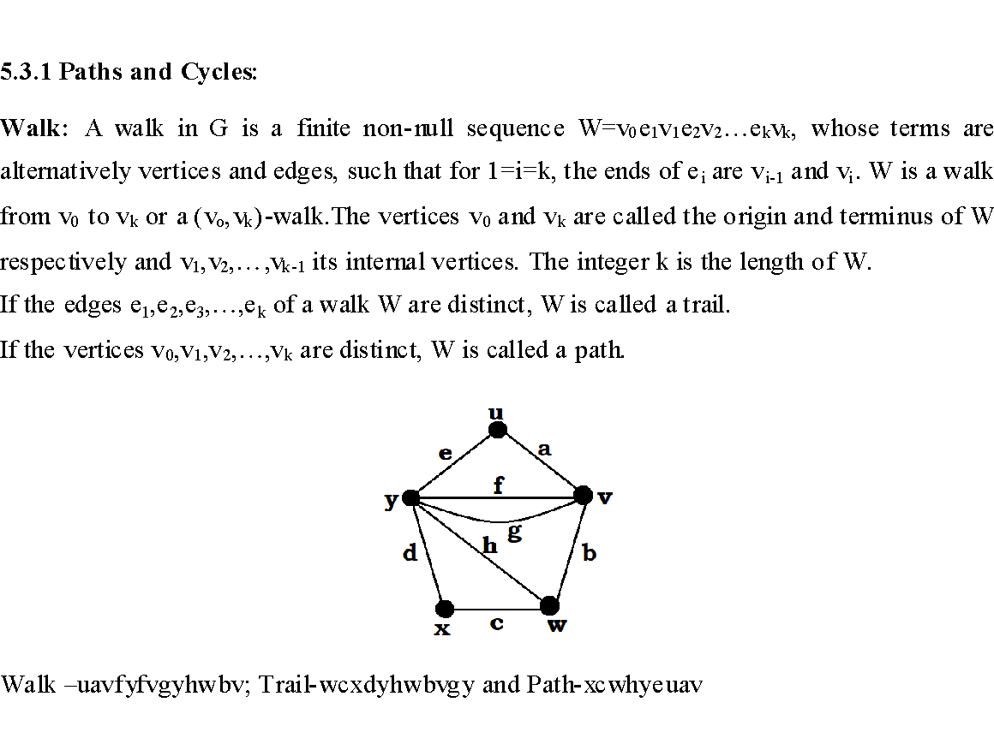

Slide 26
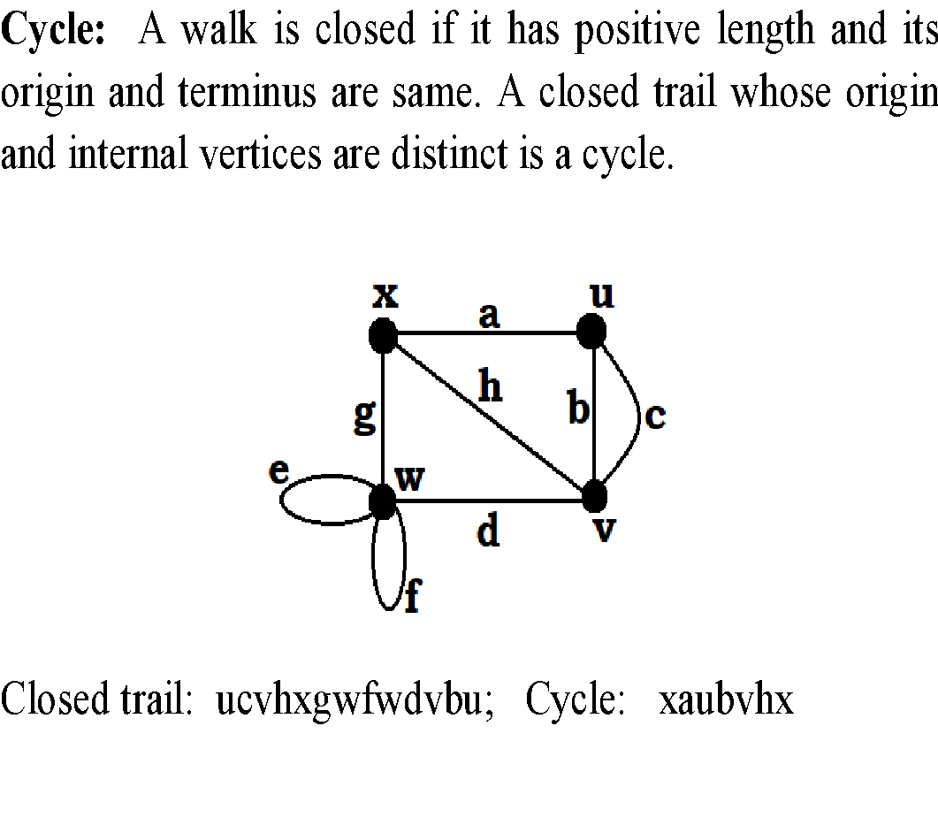

Slide 27
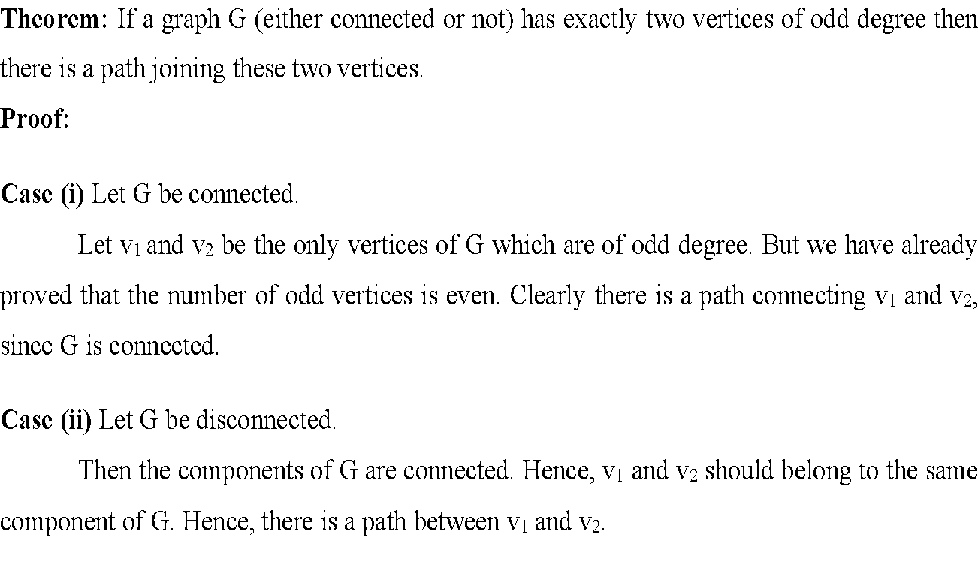

Slide 28
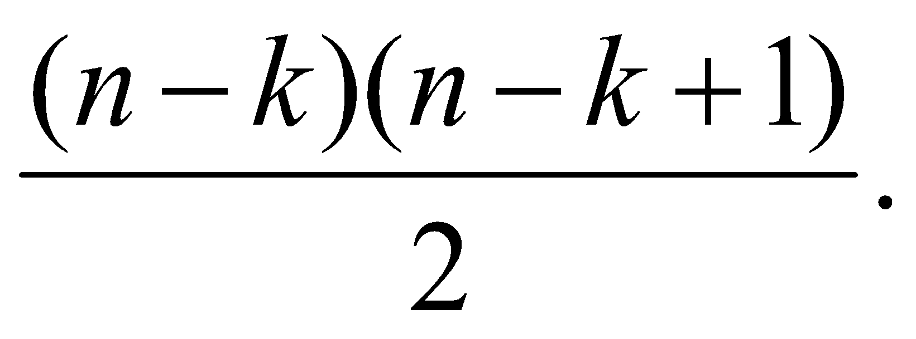
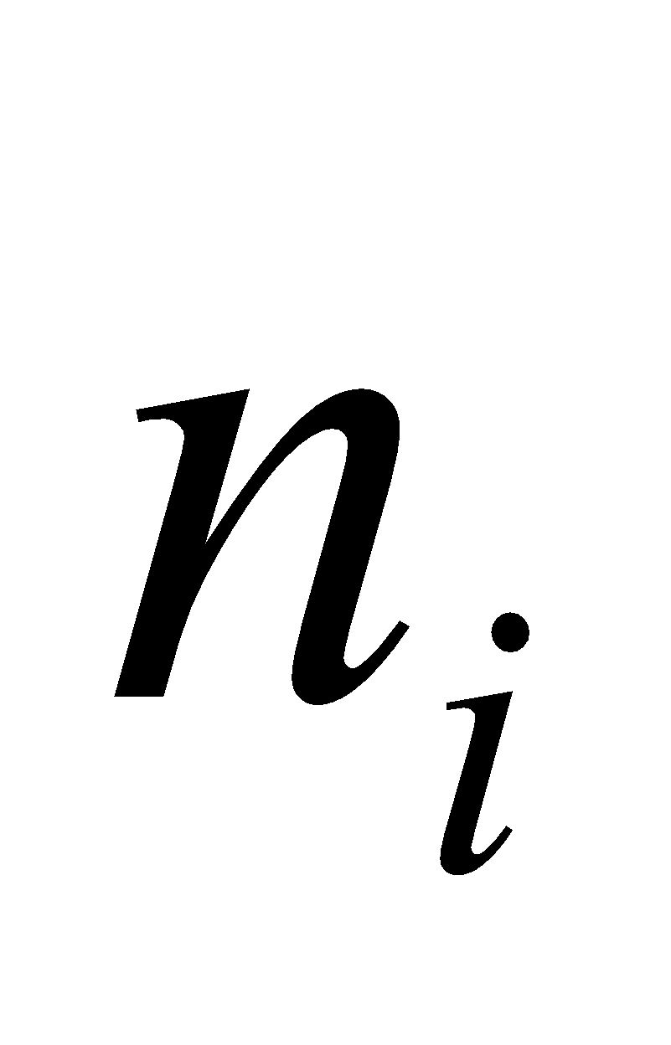
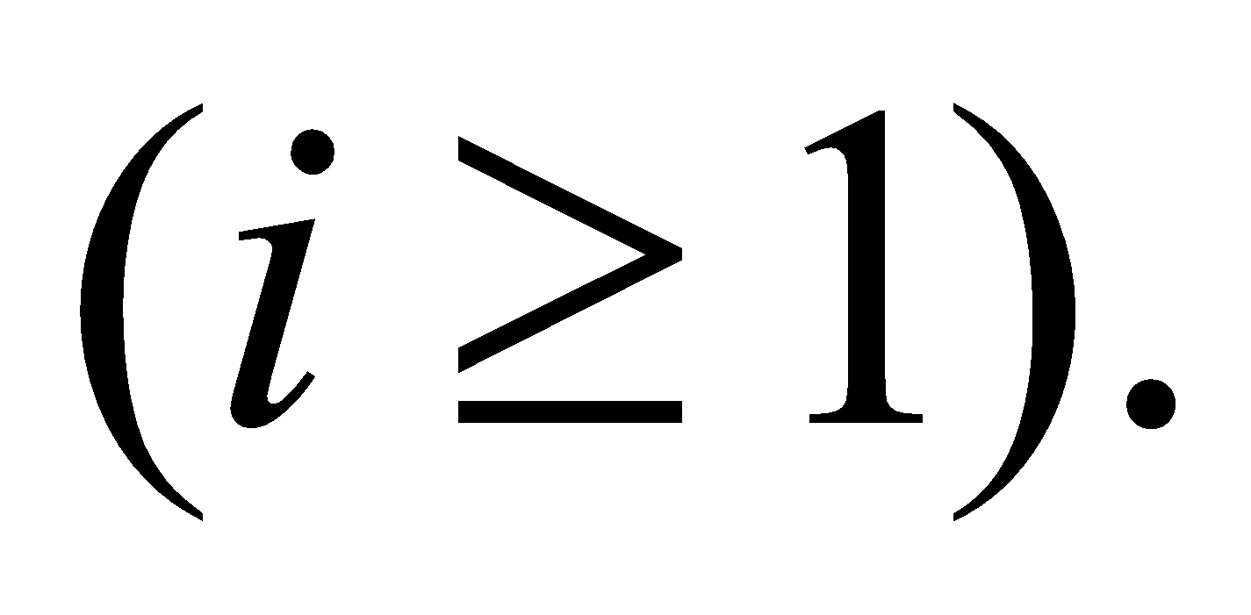
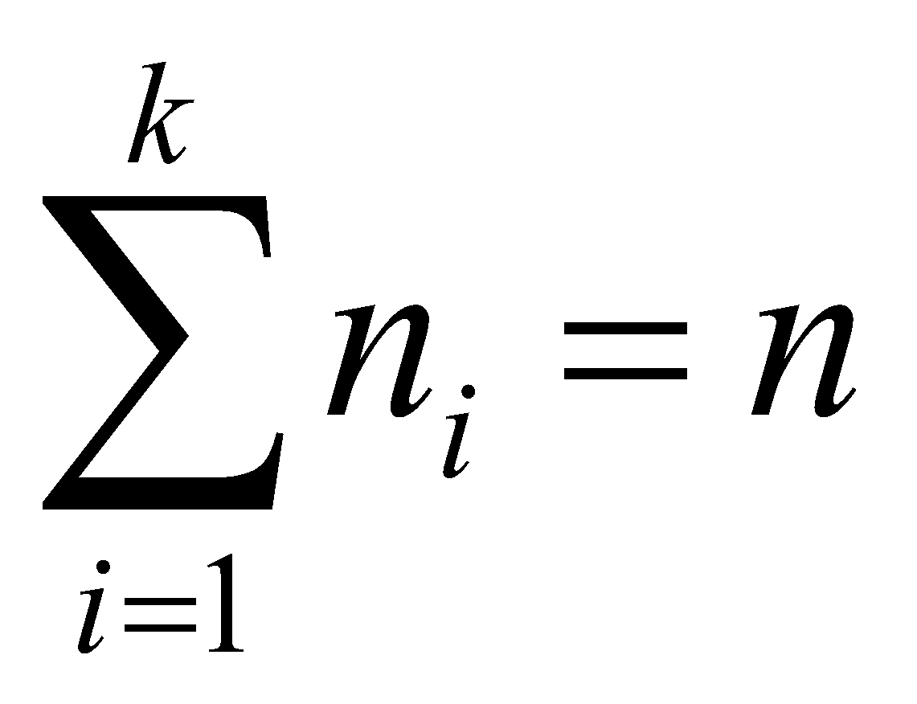
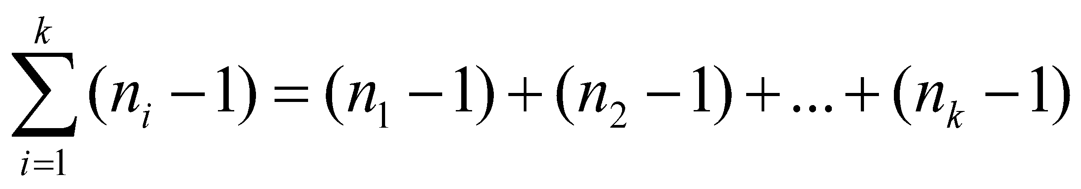
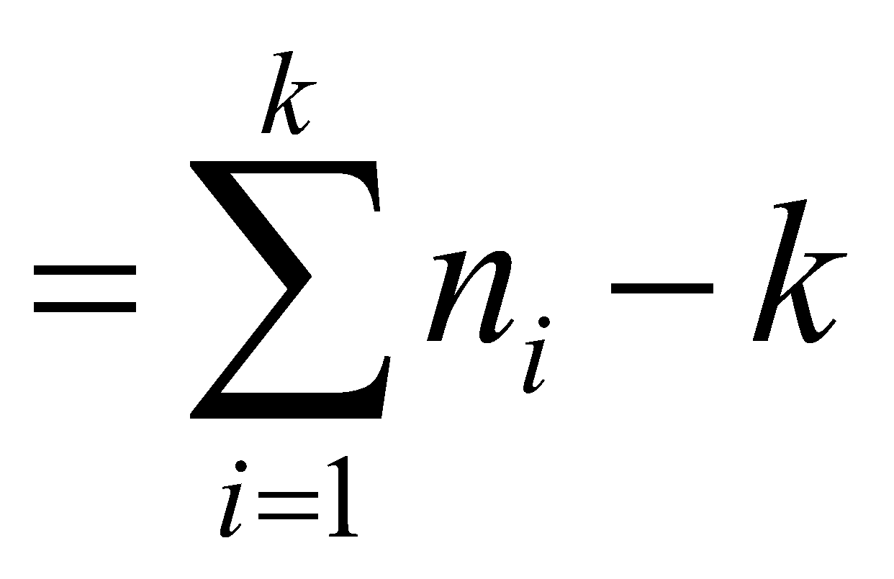
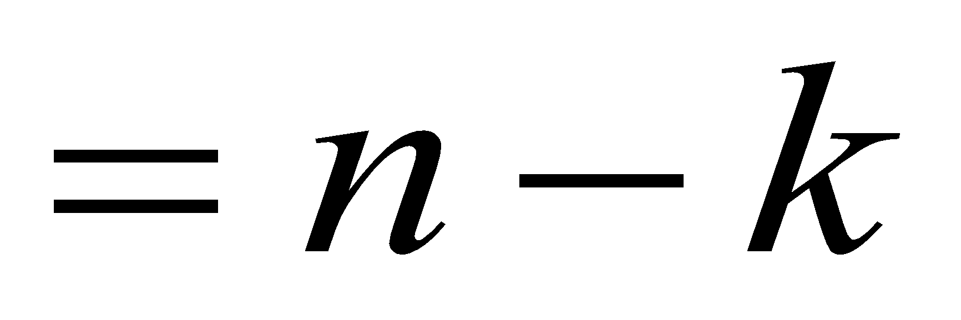
Theorem: The maximum number of edges in a simple connected graph G with n vertices and k components is
Proof:
Let the number of vertices in the i^{th} component of G be
Then n₁+n₂+…+n_{k}= n or - (1)
Hence

Slide 29
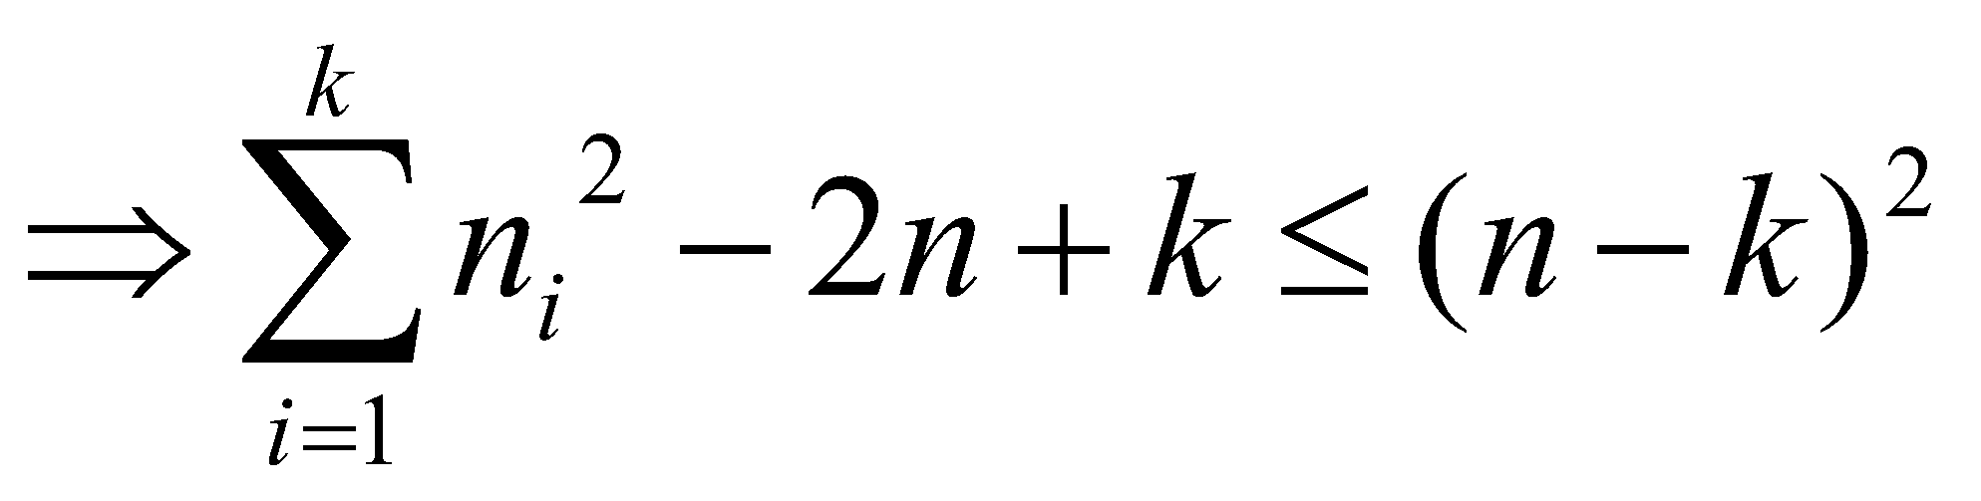
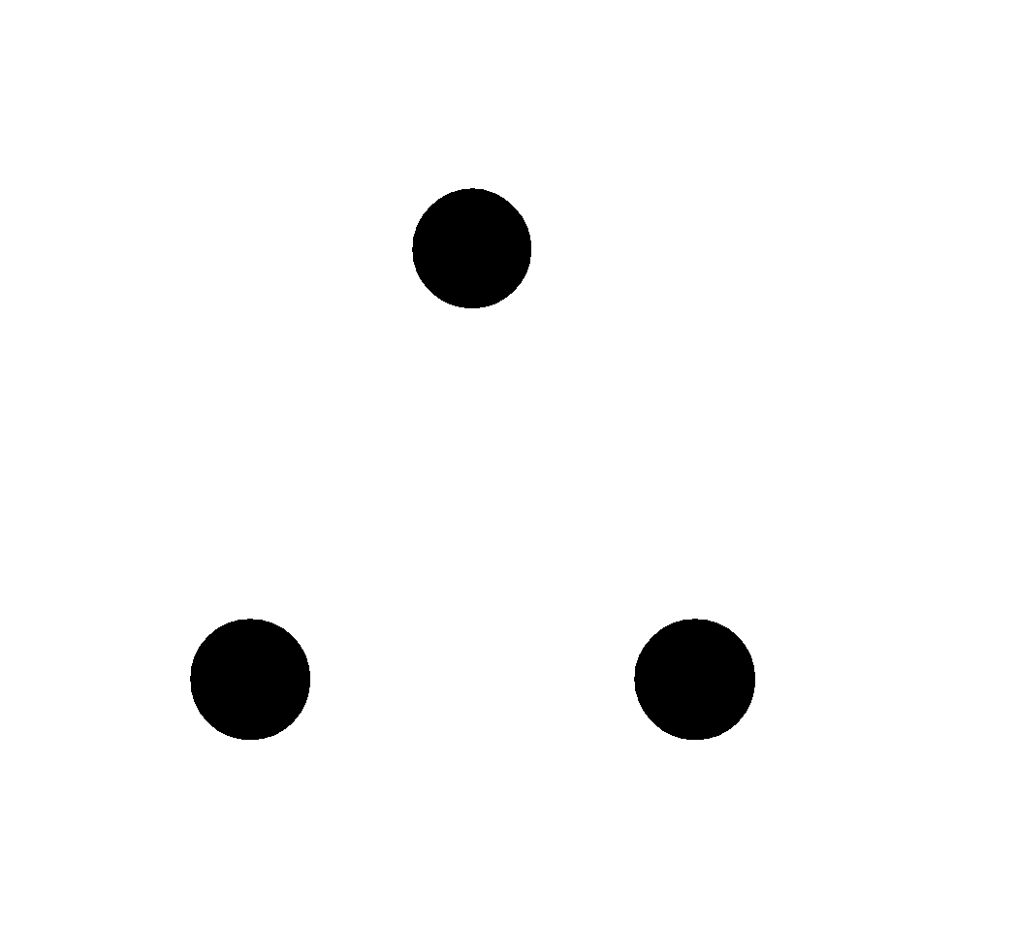
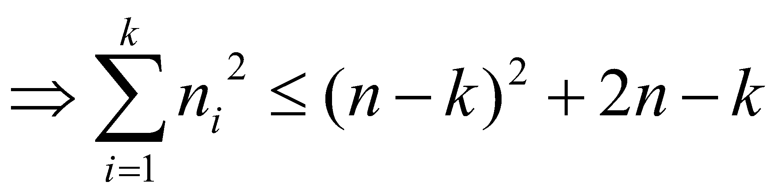
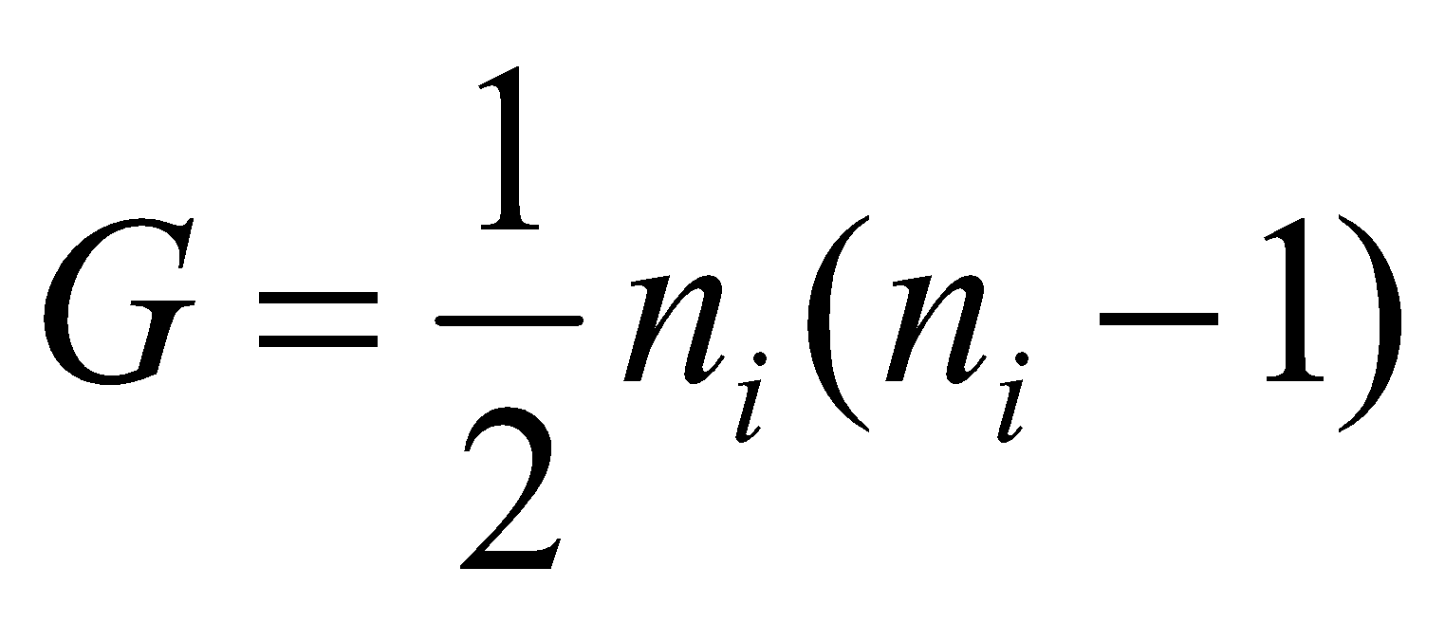
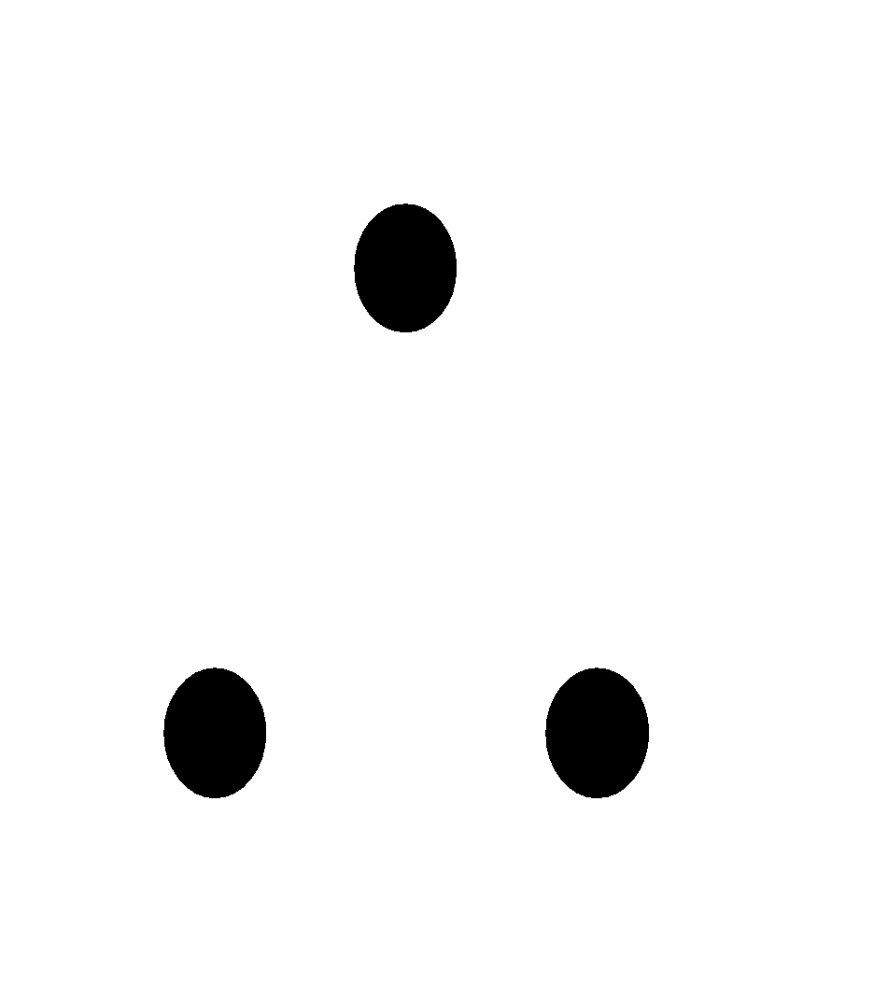
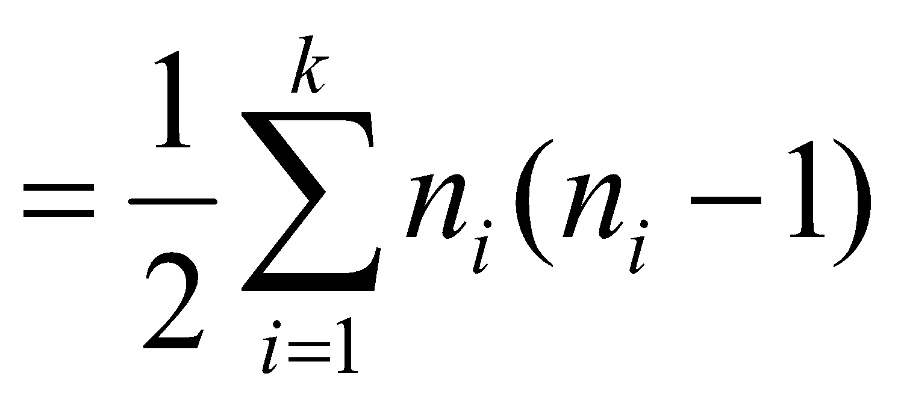
Squaring on both sides we get,
- (2)
Now the maximum number of edges in the i^{th} component of
maximum number of edges of G,

Slide 30
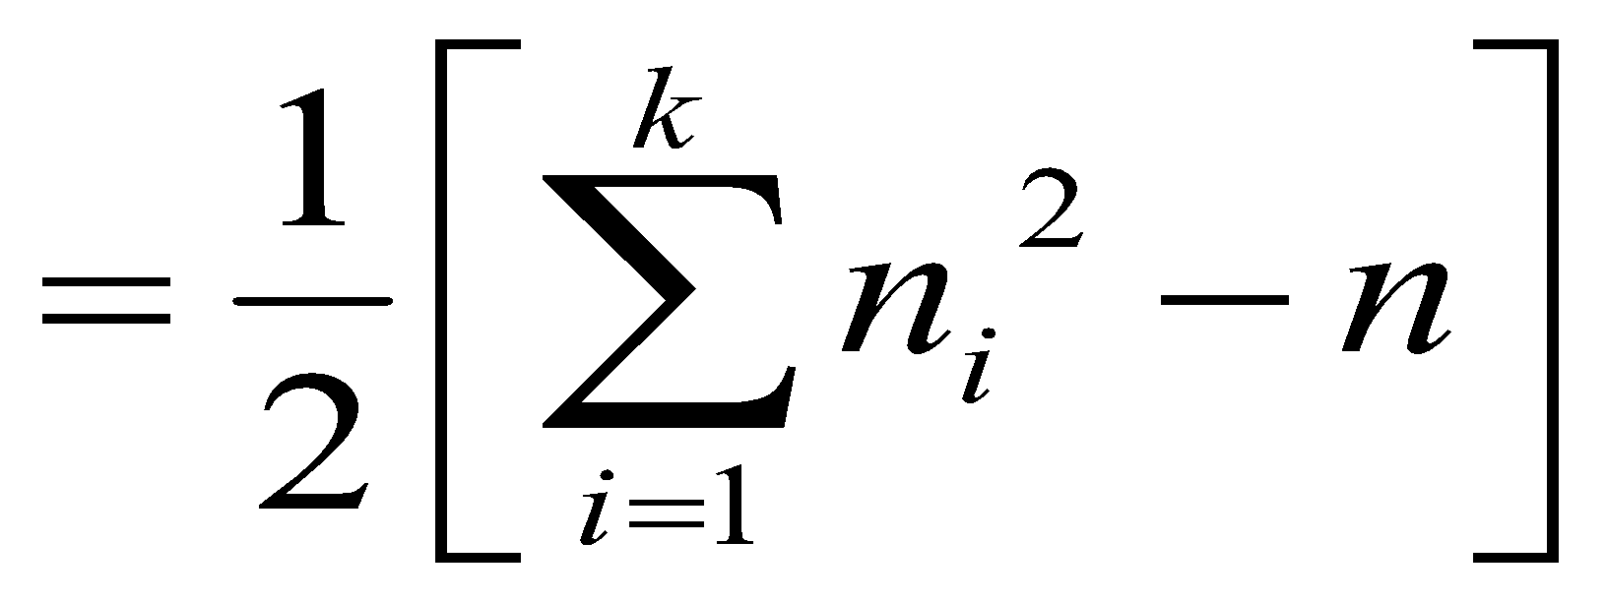
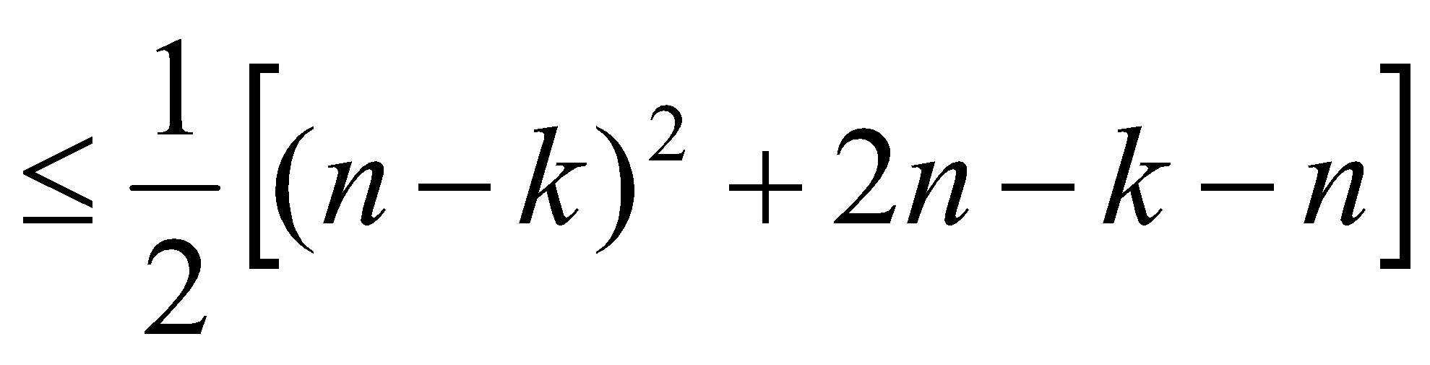
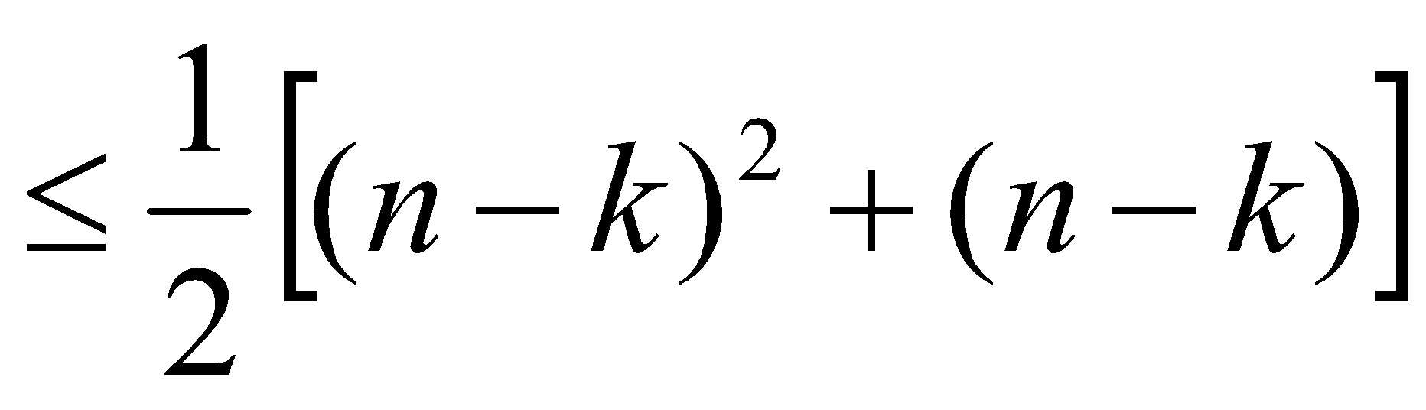
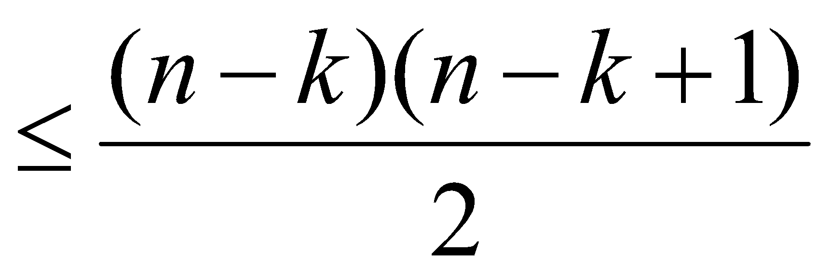
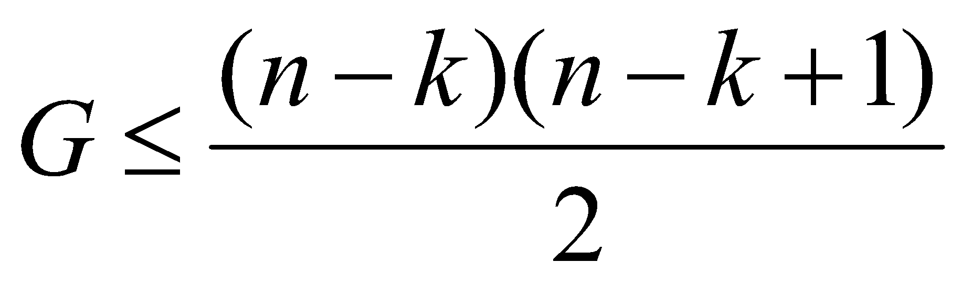
The maximum number of edges of

Slide 31
Eulerian Path: A path of graph G is called an Eulerian path, if it includes each edge of G exactly once
Eulerian Circuit: A circuit of a graph G is called an Eulerian circuit, if it include each edge of G exactly once.
Eulerian Graph: A graph containing an Eulerian circuit is called an Euler graph

Slide 32
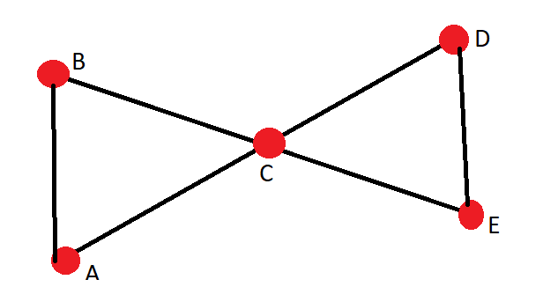
EULERIAN CIRCUIT
deg(A)=2
deg(B)=2
deg(C) =4
deg(D)=2
deg(E)=2
A-B-C-E-D-C-A
Theorem: A connected graph contains an Eulerian circuit if and only if each of its vertices is of even degree.

Slide 33

EULERIAN PATH
A-B-C-D-E-F
Theorem: A connected graph contains an Euler path, if and only if it has exactly two vertices of odd degree.

Slide 34
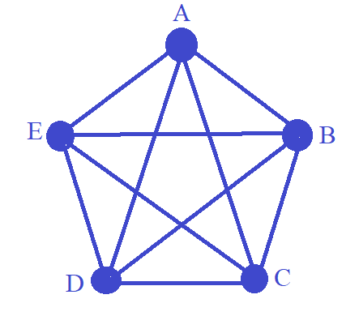
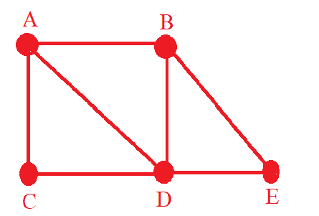
Find an Euler path or an Euler circuit, if it exists for the following graphs:
G1
G2

Slide 35
Hamiltonian Path: A path of a graph G is called a Hamiltonian path, if it includes each vertex of G exactly once.
Hamiltonian Circuit: A circuit of a graph G is called a Hamiltonian circuit, if it includes each vertex of G exactly once, except the starting and end vertices which appear twice.
Hamiltonian Graph: A graph containing a Hamiltonian circuit is called a Hamiltonian graph.

Slide 36
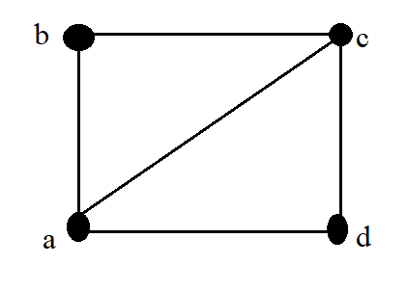
Hamiltonian Circuit
a-b-c-d-a

Slide 37
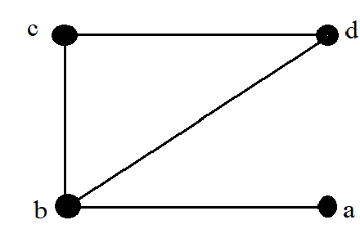
Hamiltonian Path
a-b-c-d

Slide 38

Matrix Representation of Graphs
Adjacency Matrix Representation: If an Undirected Graph G consists of n vertices then the adjacency matrix of a graph is an n x n matrix A = [a_{ij}] and defined by
If there exists an edge between vertex v_{i} and v_{j}, where i is a row and j is a column then the value of a_{ij}=1.
If there is no edge between vertex v_{i} and v_{j}, then value of a_{ij}=0.

Slide 39




Find the adjacency matrix M_{A} of graph G shown in Fig:
Since graph G consist of four vertices. Therefore, the adjacency matrix will be 4 x 4 matrix.

Slide 40



Incidence Matrix Representation: If an Undirected Graph G consists of n vertices and m edges, then the incidence matrix is an n x m matrix C = [c_{ij}] and defined by
by
Consider the undirected graph G as shown in fig. Find its incidence matrix M_{I}.
:

Slide 41






Slide 42

Verify handshaking theorem for the following digraph

Slide 43




Graph colouring
A graph has been coloured if colour is assigned to each vertex in such a way that adjacent vertices have different colours.

Slide 44
Vertex colouring of a graph G is a mapping from f:V(G) to S.
The elements of S are called colors.
The vertices of one color form a color class.
If |S| = k then it is k-coloring.
A graph is k colorable if it has proper k-coloring.
In proper coloring each color class is a stable set.
Therefore, one may consider k-coloring as a partition of the vertex set of G into k stable sets which are disjoint.

Slide 45

Chromatic number

Slide 46


Slide 47


Slide 48


Slide 49


Slide 50

Applications of graph coloring

Slide 51

Edge colouring: An edge colouring of G is a mapping from the edge set E(G) to the elements of S. The edges of one colour form a colour class. If |S|=k then it is called k-edge colouring (objective is to use minimum number of colours).
Weisstein, Eric W. "Edge Coloring." From MathWorld--A Wolfram Web Resource. http://mathworld.wolfram.com/EdgeColoring.html

Slide 52


Slide 53

TREES
A connected graph without any circuits is called a tree. It is a simple graph and has no loops and no parallel edges.
G1 and G4 are trees other two graphs contain circuit.

Slide 54


Slide 55
PROPERTIES OF TREES
An undirected graph is a tree, if and only if, there is a unique simple path between every pair of vertices.
A tree with n vertices has n-1 edges.
Any connected graph with n vertices and n-1 edges is called a tree.
Any circuitless graph with n vertices and n-1 edges is a tree.

Slide 56


Slide 57
Property 2:
If G is a tree with n vertices then G has n-1 edges.
Proof: Proof is by induction.
Basis step:If n=1, the number of vertices is one and the number of edges is zero.
Hence the theorem is true for n=1.
Induction step: For n=2, the number of vertices is 2 and edges is 1. Hence also true for n=2
Assume that the theorem is true for .
Consider a tree with k+1 vertices. Let e_{ij} be an edge of the tree connecting v_{i} and v_{j}. Since G is a tree e_{ij} is the only edge of the tree connecting v_{i} and v_{j}.
Hence deleting e_{ij} will disconnect G into two components.

Slide 58



Slide 59


Slide 60


Slide 61


Slide 62

SPANNING TREES
If the subgraph T of a connected graph G is a tree containing all the vertices of G then T is called the spanning tree of G.
Example:
Since G has three vertices any spanning tree of G will also have three vertices and hence two edges.
This can be done in 3C2 ways that is 3 ways as shown in the figure.

Slide 63


Slide 64


Slide 65
MINIMUM SPANNING TREE
Definition:
If G is a connected weighted graph, the spanning tree of G with the smallest total weight is called minimum spanning tree of G.
Two popular algorithms for constructing minimum spanning trees is
Prim’s Algorithm
Kruskal’s Algorithm
KRUSKAL’S ALGORITHM
The edges of the graph are arranged in the order of increasing weights
An edge with minimum weight is selected as an edge of the required spanning tree.
Those edges with minimum weight that do not form a circuit with already selected edges are successively added.
The procedure terminates once n-1 edges have been selected.
NOTE:
The weight of a minimum spanning tree is unique, different minimum spanning trees are possible if 2 or more edges have same weight

Slide 66

Problem: Find the minimum spanning tree for the weighted graph shown in the figure by using Kruskal’s algorithm.

Slide 67
Solution: To find the minimum spanning tree for the weighted graph shown in the figure by using Kruskal’s algorithm.
Number of vertices is 6 .
Hence the number of edges to be considered is 5.
Edge | Weight | Included or not | If not included circuit formed
1-2 | 1 | Yes | -
6-3 | 2 | Yes | -
5-4 | 6 | Yes | -
1-3 | 9 | Yes | -
5-6 | 9 | Yes | -

Slide 68


The other spanning trees possible for the same graph are
There are two spanning trees for the above problem.
Their minimum spanning weight is 27.(unique)

Slide 69


Slide 70


Slide 71


